Slide 1
Sequence labeling: POS Tagger
Knowledge & Language Engineering Lab.

Slide 2
Contents
Sequence Labeling
Introduction
Method
Practice
Simple POS tagger using HMM Algorithm

Slide 3
Sequence Labeling
[ Relation Extraction ]

Slide 4
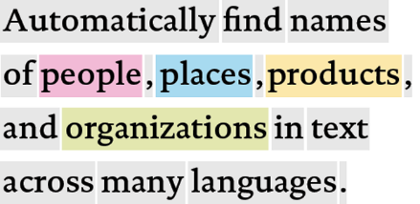
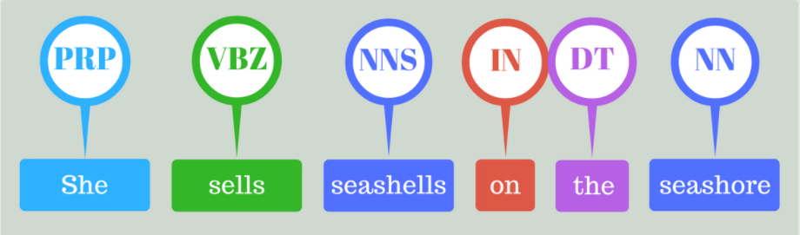
Introduction
Sequence labeling
A pattern recognition task that classifies a categorical label to each member of a sequence elements.
In NLP, which deals with sequential data, sequence labeling is one of the major task.
Tasks or subtasks
Named entity recognition | Part of speech tagging | Spacing problem
아버지가방에들어가신다.
아버지가 방에 들어가신다.

Slide 5
Introduction
Sequential Data
Data stored in chronological order.
Generally, each element is related to each other.
E.g.)
Video: a sequence of frames
Text: a sequence of words
Voice: a sequence of signals.

Slide 6
Methods
Sequence labeling methods
Vector space model
Neural network model
Structured SVM
Probabilistic model
Hidden Markov Model (HMM)
Conditional Random Field (CRF)
Neural network model

Slide 7
Methods
Sequence labeling methods
Vector space model
Neural network model
Structured SVM
Probabilistic model
Hidden Markov Model (HMM)
Conditional Random Field (CRF)
Neural network model

Slide 8

Hidden Markov Model
$y_{1:N}^{∗}={argmax}_{y_{1:N}}P\left(y_{1:N} | x_{1:N}\right)$
($Bayes rule$)
$={argmax}_{y_{1:N}}P\left(x_{1:N} | y_{1:N}\right)P$($y_{1:N}$)
$={argmax}_{y_{1:N}}\prod_{k=1}^{N}{P\left(x_{k} | x_{1:k−1},y_{1:K}\right)}\prod_{k=1}^{N}{P(y_{k}|y_{1:k−1})}$
($Markov assumption$)
$≈{argmax}_{y_{1:N}}\prod_{k=1}^{N}{P\left(x_{k} | y_{k}\right)}\prod_{k=1}^{N}{P\left(y_{k} | y_{k−1}\right)}$

Slide 9

Hidden Markov Model
$y_{1:N}^{∗}={argmax}_{y_{1:N}}P\left(y_{1:N} | x_{1:N}\right)$
($Bayes rule$)
$={argmax}_{y_{1:N}}P\left(x_{1:N} | y_{1:N}\right)P$($y_{1:N}$)
$={argmax}_{y_{1:N}}\prod_{k=1}^{N}{P\left(x_{k} | x_{1:k−1},y_{1:N}\right)}\prod_{k=1}^{N}{P(y_{k}|y_{1:k−1})}$
($Markov assumption$)
$≈{argmax}_{y_{1:N}}\prod_{k=1}^{N}{P\left(x_{k} | y_{k}\right)}\prod_{k=1}^{N}{P\left(y_{k} | y_{k−1}\right)}$
NN
VBD
DT
NN
품사 태그
단어 seq.
John
saw
the
saw

Slide 10
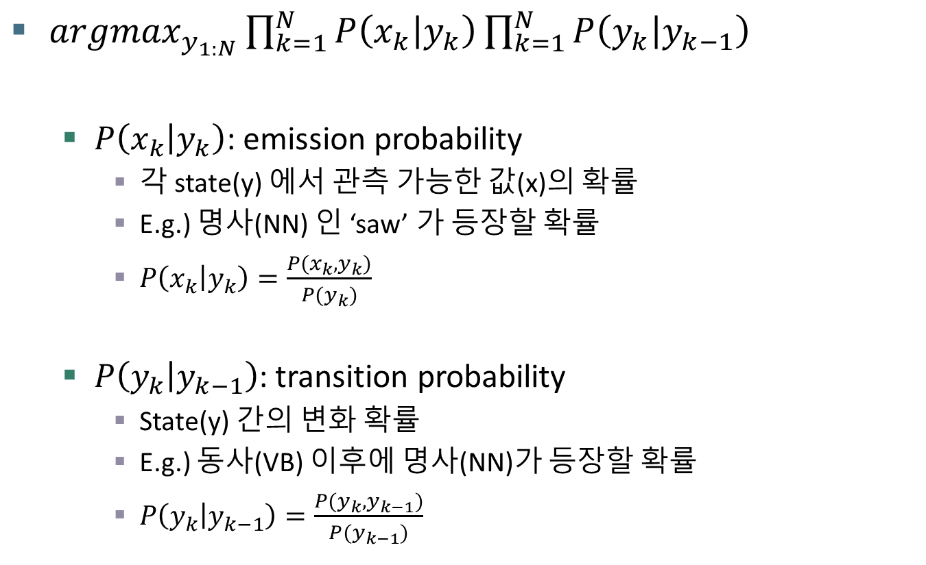
Hidden Markov Model
${argmax}_{y_{1:N}}\prod_{k=1}^{N}{P\left(x_{k} | y_{k}\right)}\prod_{k=1}^{N}{P\left(y_{k} | y_{k−1}\right)}$
$P\left(x_{k} | y_{k}\right)$: emission probability
각 state(y) 에서 관측 가능한 값(x)의 확률
E.g.) 명사(NN) 인 ‘saw’ 가 등장할 확률
$P\left(x_{k} | y_{k}\right)=\frac{P(x_{k},y_{k})}{P(y_{k})}$
$P\left(y_{k} | y_{k−1}\right)$: transition probability
State(y) 간의 변화 확률
E.g.) 동사(VB) 이후에 명사(NN)가 등장할 확률
$P\left(y_{k} | y_{k−1}\right)=\frac{{P(y}_{k},y_{k−1})}{P(y_{k−1})}$

Slide 11
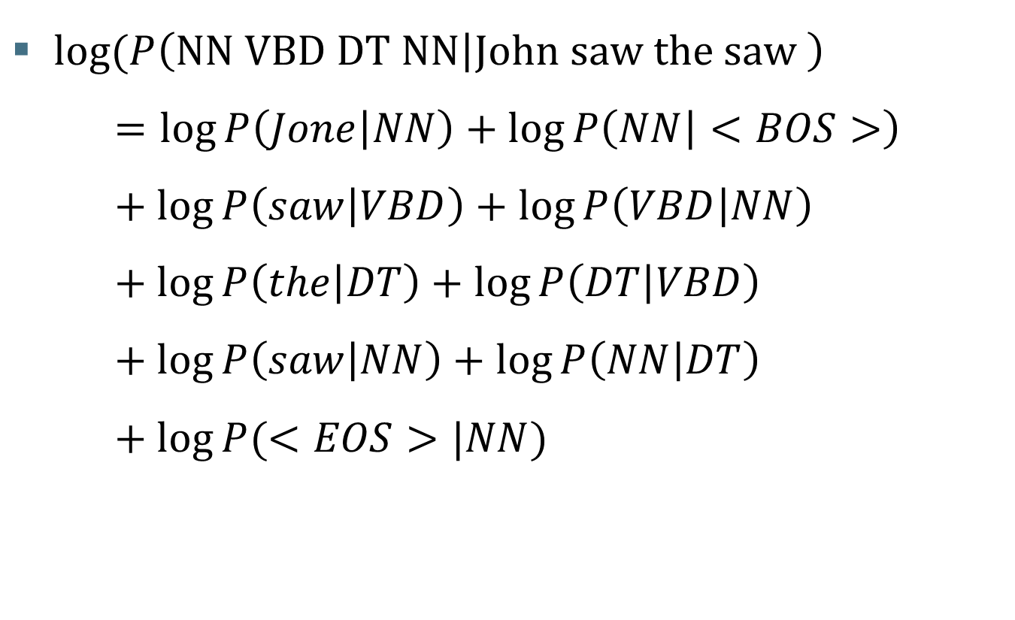
Hidden Markov Model
$log⁡(P\left(\text{NN} \text{VBD} \text{DT} \text{NN} | \text{John} \text{saw} \text{the} \text{saw} \right)$ $=\log{P\left(Jone | NN\right)}+\log{P\left(NN | <BOS>\right)}+\log{P\left(saw | VBD\right)}+\log{P\left(VBD | NN\right)}+\log{P\left(the | DT\right)}+\log{P\left(DT | VBD\right)}+\log{P\left(saw | NN\right)}+\log{P\left(NN | DT\right)}+\log{P(<EOS>|NN)}$

Slide 12
practice

Slide 13
KLE tagset
부가자료: KLE_Tagset.docx 파일 참고

Slide 14

preprocessing
Preprocess each line with a list of tuples.
[[($word_{1}, tag_{1}$), ($word_{2}, tag_{2}$), …, ($word_{n}, tag_{n}$), [($word_{1}, tag_{1}$), ($word_{2}, tag_{2}$), …, ($word_{n}, tag_{n}$) $⋮$ $\text{[(}word_{1}, tag_{1}\text{), (}word_{2}, tag_{2}\text{), …, (}word_{n}, tag_{n}\text{)}$]]
그/CT 도/fjb 강하/YBH ㄴ/fmotg 카리스마/CMC 를/fjco 필요/CMC 하/fph ㅂ니다/fmof ./g
애플/CMC 이/fjcs 80/CS %/g 로/fjcao 그/SG 뒤/CMC 를/fjco 쫓/YBD 았/fmb 습니다/fmof ./g
이제/SBO 참가자들/CMC 이/fjcs 기념촬영/CMC 을/fjco 하/YBD 고/fmoc 있/YA 다/fmof ./g
[[(그, CT), (도, fjb), (강하, YBH), ..., (ㅂ니다, fmof), (., g)],
[(애플, CMC), (이, fjcs), (80, CS), …, (습니다, fmof), (., g)],
[(이제, SBO), (참가자들, CMC), (이, fjcs) ,…, (다, fmof), (., g)]]

Slide 15
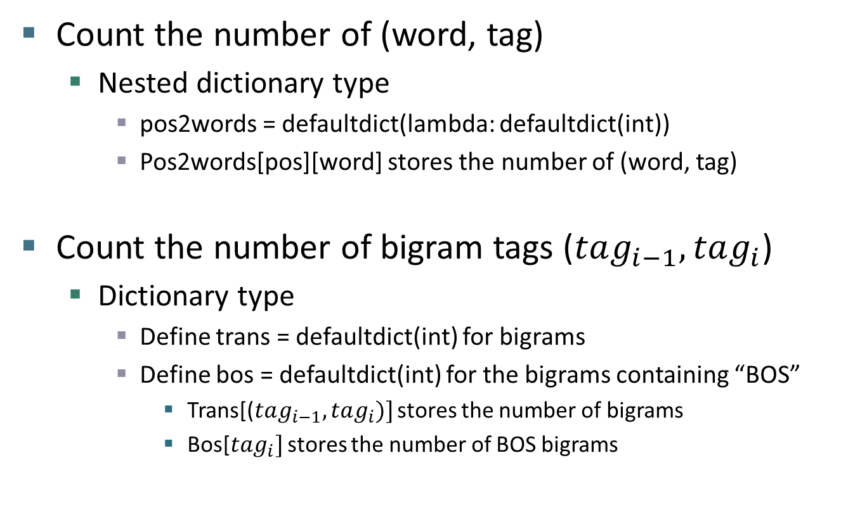
Train function
Count the number of (word, tag)
Nested dictionary type
pos2words = defaultdict(lambda: defaultdict(int))
Pos2words[pos][word] stores the number of (word, tag)
Count the number of bigram tags ($tag_{i−1}, tag_{i}$)
Dictionary type
Define trans = defaultdict(int) for bigrams
Define bos = defaultdict(int) for the bigrams containing “BOS”
Trans[($tag_{i−1}, tag_{i})]$ stores the number of bigrams
Bos[$tag_{i}]$ stores the number of BOS bigrams

Slide 16
Train function
Example
pos2words
trans
bos
{CMC: {아버지: 10, 올림픽: 15, ..},
CMP: {구글: 20, 애플: 15, ..}
YBD: {마시: 10, 듣: 20, …}}
{(CMC, fjb): 20, (CMP, fjb): 31, (fjco, fd): 55, ..}
{CMP: 100, CMC: 200, CT: 55, …}

Slide 17
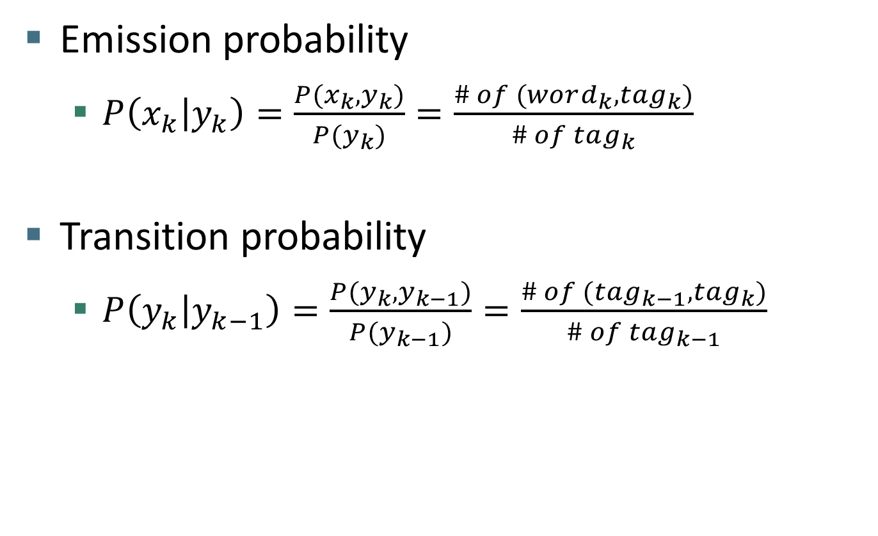
Train function
Emission probability
$P\left(x_{k} | y_{k}\right)=\frac{P(x_{k},y_{k})}{P(y_{k})}=\frac{\# of (word_{k}, tag_{k})}{\# of tag_{k}}$
Transition probability
$P\left(y_{k} | y_{k−1}\right)=\frac{{P(y}_{k},y_{k−1})}{P(y_{k−1})}=\frac{\# of (tag_{k−1}, tag_{k})}{\# of tag_{k−1}}$

Slide 18

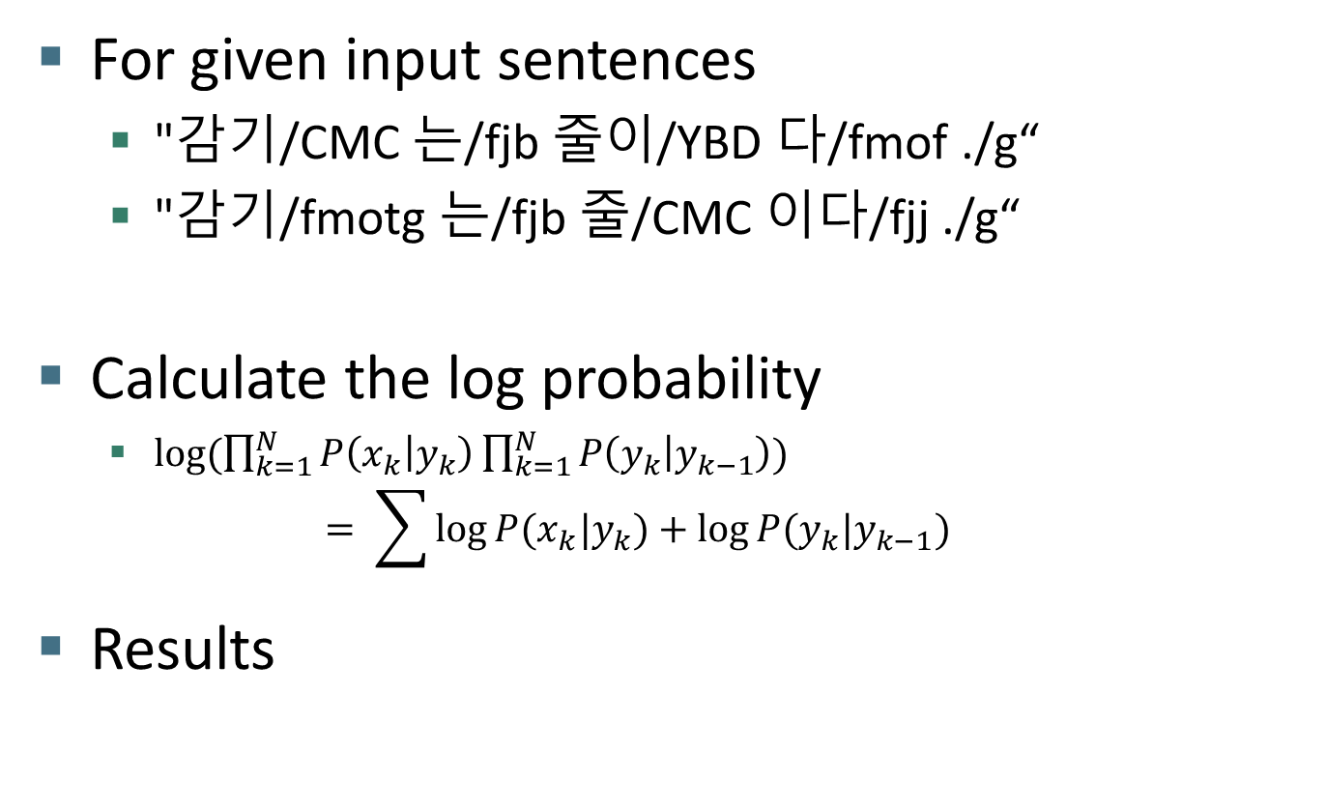
Inference
For given input sentences
"감기/CMC 는/fjb 줄이/YBD 다/fmof ./g“
"감기/fmotg 는/fjb 줄/CMC 이다/fjj ./g“
Calculate the log probability
$\log{(\prod_{k=1}^{N}{P\left(x_{k} | y_{k}\right)}\prod_{k=1}^{N}{P\left(y_{k} | y_{k−1}\right)}})$ $= \sum{\log{P(x_{k}|y_{k})}+\log{P(y_{k}|y_{k−1})}}$
Results

Slide 19
end

